Slide 1
Interconnecting CDNs
Bruce Davie
bsd@cisco.com

Slide 2
Interconnecting CDNs
Sometimes called “CDN Federation” or “CDN Peering” but those terms have some baggage
Vision is analogous to the interconnection of ISPs that enabled growth of the Internet
Today’s picture analogous to the closed packet networks of the 1970s (e.g. Telenet, Tymnet, etc.)
Many ISPs operating/building CDNs for their own services
Few (if any) are actively going after Akamai

Slide 3
CDN Interconnect Overview
Expand footprint of CDN beyond a single provider
Benefits include:
Better experience for customers when they’re “off-net”
Better value proposition from a CDN to content owners
Bring more content into the CDN (including content that might otherwise be OTT)
More directly control how content flows to off-net clients via explicit selection of downstream CDN
Content owners don’t need agreements with every CDN in the world
Global CDN operators might not agree that these are benefits
Nor will those who don’t believe in CDNs

Slide 4
Today’s Situation
Content Provider
Content Provider
CDN Provider
CDN Provider

Slide 5
CDN Interconnection Vision
Content Provider
Content Provider only needs contractual+technical relationship with 1 (or a few) CDN
Content Provider
Content Provider
Content Provider
CDN Provider
CDN Provider
CDN Provider
Content Provider
CDNI
Gateway
CDNI
Gateway
CDNI
Gateway
CDN Provider
CDN Provider
Content Provider
CDNI
Gateway
CDNI
Gateway
Content Provider
Content delivered to user by downstream CDN
Selection of CDN driven by upstream CDN policy

Slide 6
CDNI Functional Components
CP0
ensures client request is redirected towards the right cache in the right CDN.
Origin Server
Request Routing Engine
CDN1
ensures CDN2 can “charge” CDN1 for CDN2 deliveries.
Ensures CDN1 can “charge” CP0 for CDN1 and CDN2 deliveries.
Analytics & Accounting
Cache
Client
Cache
Request Routing
Accounting/ Logging
Acquisition
ensures CP0 can monitor all deliveries (though CDN1 and CDN2).
Ensures CDN1 can monitor CDN2 deliveries performed on its behalf
Request Routing Engine
CDN2
Delivery
Analytics & Accounting
ensures CDN2 can get content from CDN1, and CDN1 can get it from CP0.
Pre-positioning & Dynamic Acquisition.
Cache
Cache

Slide 7
Example Request Routing
CP0
Origin Server
1. Client talks to RRE in CDN1 “as normal”
Request Routing Engine
Client
CDN1
1
3
2. CDN1 decides that CDN2 should serve this request, asks RRE in CDN2 which cache
2
Cache
Cache
5
4
3. RRE returns appropriate URL to client (e.g. HTTP redirect)
Request Routing Engine
4,5. Client requests content from cache and receives it
CDN2
Analytics & Accounting
Cache
Cache

Slide 8
CDN Interconnection Standards Status
“CDN Interconnect” Working Group in IETF:
Problem Statement, Requirements, Framework & Use Case Internet-Drafts
First WG meeting held in July (IETF81)
Some other bodies have specs for external CDN interfaces, but do not have CDN Interconnection in scope (e.g. ATIS IIF Content On Demand)
Some bodies have CDN Interconnection in scope, early work (e.g. ETSI MCD, ETSI TISPAN)

Slide 9
CDNI at IETF
CDNI WG defining interfaces between two CDNs, “upstream” and “downstream”
Bilateral agreement, anything else can be done by induction
A CDN may be upstream for some requests, downstream for others
Classes of information exchanged across interface include:
Control
Metadata
Logging
Request Routing information
Content
Trying to use existing protocols, languages, file formats etc. wherever possible

Slide 10
CDNI Interface Components
Control
To bootstrap, configure and control other interfaces
Advertise capabilities (e.g. types of content delivery, region of coverage)
Metadata
Provide all the information about what data is available and information relevant to its distribution (e.g. geo restrictions, time limits, etc.)
Not content metadata such as cast, rating, genre etc.
Logging
Information necessary to determine payments and monitor performance
e.g. what content delivered, how many bytes, what QoS achieved
Request Routing
Exchange information to achieve desired chain of CDN delegation
Ultimately direct client to a cache node in leaf CDN with the content
Notes:
NPS/ALTO can have a role in request routing – feed info via CDNI control interface re: which CDN for which “footprint” – this may be ALTO-like interface
CDN selector can then query proximity fn that is fed by this ALTO info.

Slide 11
CDNI status
A complete solution would
Work with any vendor’s CDN equipment
Deal with any topology of interconnected CDNs
Allow any number of levels of CDN between origin and client
Complete solution will probably take a while, but we’ve already developed and trialed partial solution
Two CDNs, two vendors’ equipment – details follow
CDN Federation Trial underway
Phase 1 with 5 SPs started Feb 2011, almost complete
Phase 2 likely to expand to more SPs and maybe content providers too

Slide 12
Summary of CDNI Pilot Ph1 Outcomes
Tested bilateral, multilateral and cascaded (3-level) interconnect
Multiple delivery types (HTTP, HLS, Smooth/Silverlight etc.)
Transparent to Content Provider (i.e. looks like single CDN)
Hierarchical & Dynamic acquisition:
dCDN obtains content from as needed from uCDN, with no visibility of CSPs
Logging & accounting info exchanged bilaterally and via “CDN exchange”
Basic performance testing

Slide 13
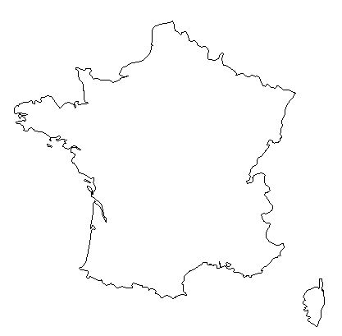
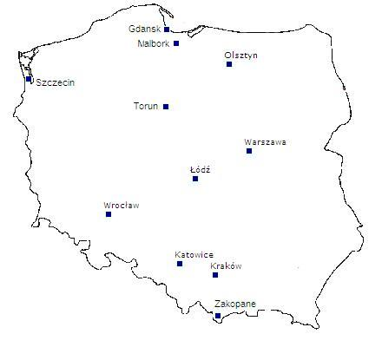
Orange/Cisco/Coblitz CDN Interconnect Demo: Stage 1: Dynamic Acquisition from Origin Server
French CP
Polish CP
Origin Server
Origin Server
Business Relationship
Business Relationship
Request Routing Engine
Request Routing Engine
FT CDN
(Cisco CDS-IS)
TPSA CDN
(Coblitz)
Cache
Cache
Cache
Cache
Client
Client
France
Poland

Slide 14
Orange/Cisco/Coblitz CDN Interconnect Demo
French CP
Polish CP
Origin Server
Origin Server
Business Relationship
Business Relationship
Request Routing Engine
Request Routing Engine
FT CDN
(Cisco CDS-IS)
TPSA CDN
(Coblitz)
Cache
Cache
Cache
Cache
Cache
Cache
Client
Client
France
Poland

Slide 15
CDN Interconnect Message Flow: French Content delivered in Poland, Stage 1
French CP
CDN Selection based on user country
Origin Server
URI Mapping:
http://cdni.ft.com/… → http://cdni.tpsa.com/$1
Get
http://www.tf1.fr/video/movie1.xyz
3d
1c
Request Routing Engine
Request Routing Engine
1b
GeoLoc
Proximity
FT CDN
(Cisco CDS-IS)
TPSA CDN (Coblitz)
URI Mapping:
http://cdni.tpsa.com/… → http://$1
3c
2
Cache
Cache
Cache
3b
Redirect
http://cdni.tpsa.com/www.tf1.fr/video/movie1.xyz
1
4
3
Get
http://cdni.ft.com/www.tf1.fr/video/movie1.xyz
Client
Get
http://cdni.tpsa.com/www.tf1.fr/video/movie1.xyz
France
Poland

Slide 16
Request Routing Overview
End-User
CDN B
CDN A
DNS FQDN_{A}
IPaddr of A’s RR
HTTP URL_{A}
Recognize IP addr should be served from CDN B
302 URL_{B}
DNS FQDN_{B}
Recognize content to be acquired from CDN A
IPaddr of B’s Delivery Node
HTTP URL_{B}
DNS FQDN_{A}’
IPaddr of A’s Delivery Node
Origin
Server
HTTP URL_{A}’
Data
Data

Slide 17
CDNI Pilot Demonstrated Features
Fully Hierarchical System
Hierarchical acquisition in uCDN, between CDNs, and in dCDN
e.g. inter-CDN acquisition is from a streamer in uCDN, which acquires from CA, which acquires from OS
Smart Dynamic Selection of SE for inter-CDN acquisition
Transparent to CSPs
Cascaded CDNs
Content Purge
Inter-CDN prepositioning
Meta-data interface
e.g. inter-CDN time-window

Slide 18
Summary
Linkage between network and CDN offers benefits to both
More efficient network usage
Congestion avoidance improves CDN performance
Challenge: ensure that dynamics at multiple levels interact in productive ways
CDN Federation provides a means to make more content “visible” to the CDN
Reduce volume of over-the-top traffic that can’t be cached
Expand reach of CDN beyond a single provider
Better experience for customers off-net

Slide 19
CDNI Summary
CDNI – benefits of interconnection move to the content layer
Widespread deployment of limited-footprint CDNs by ISPs today
CDN Interconnect allows more leverage of that footprint
Help your customers when they are off net
Make content providers happier
Makes content “visible” to the CDN - reduce volume of uncacheable OTT
More control over routing of content
Technical feasibility established in trials
Industry interest demonstrated in IETF and pilot
Technical approach based on bilateral interconnection
Interfaces for request routing, logging/accounting, control, metadata
Rich interconnection topologies expected, “CDN exchanges” possible

